Slide 1
Brazilian E-Commerce
Olist’s Analysis
Hemen Asfaw, Sam Biner, Jacob Fried, Mary Tekele

Slide 2
AGENDA
01
BACKGROUND
05
PRICING OPTIMIZATION
Data Info
Discounts/Pricing Affecting Volume/Revenue
Strategies Maximizing Profit and Retention
02
BUSINESS PROBLEM
06
SUPPLY CHAIN LOGISTICS
Questions
Thank You
03
SALES PERFORMANCE
Market Size
Differentiators
07
RECOMMENDATIONS
04
CUSTOMER SEGMENTATION
Questions
Thank You
Where are Customers
Most Popular Products Amongst Customers
Customer Satisfaction Rates

Slide 3
01
Data Background

Slide 4
Background Information
Dataset: Brazilian E-Commerce Public Dataset by Olist
Source: Kaggle.com
9 Tables
Customer Info
Seller Info
Orders
Order Items
Order Payments
Order Reviews
Products
Product Name Translations
Geolocation Information
Observes 100k real & anonymised orders from 2016 - 2018 made across multiple Olist Stores in Brazilian Marketplaces
Storage Architecture: Relational Database Management System (RDBMS)
Data ~> Database
Uploaded using Python
Analyzed in SQL
Visualized in Tableau & PowerBI
Notes:
We used a real, anonymised, and comprehensive data from the Brazilian E-Commerce Public Dataset by Olist found on Kaggle.com that observes customer behavior, transactional history, and product-level detail for over 100k orders made between 2016 & 2018

Slide 5
02
Business Problem & Architecture

Slide 6
Business Problem
This project will analyze customer preferences and spending patterns to support an e-commerce company planning to enter the Brazilian market.
We leveraged transactional, product, and customer review data, so the company can better tailor its product catalog, pricing strategies, and marketing initiatives to meet consumer demand and maximize market entry success.
80
70
60
50
40
30
20
10
BAR GRAPH INFO 1
BAR GRAPH INFO 1
BAR GRAPH INFO 1
BAR GRAPH INFO 1
Notes:
This project will analyze customer preferences and spending patterns to support an e-commerce company planning to enter the Brazilian market. By leveraging transactional, product, and customer review data, the company can better tailor its product catalog, pricing strategies, and marketing initiatives to meet consumer demand and maximize market entry success.

Slide 7
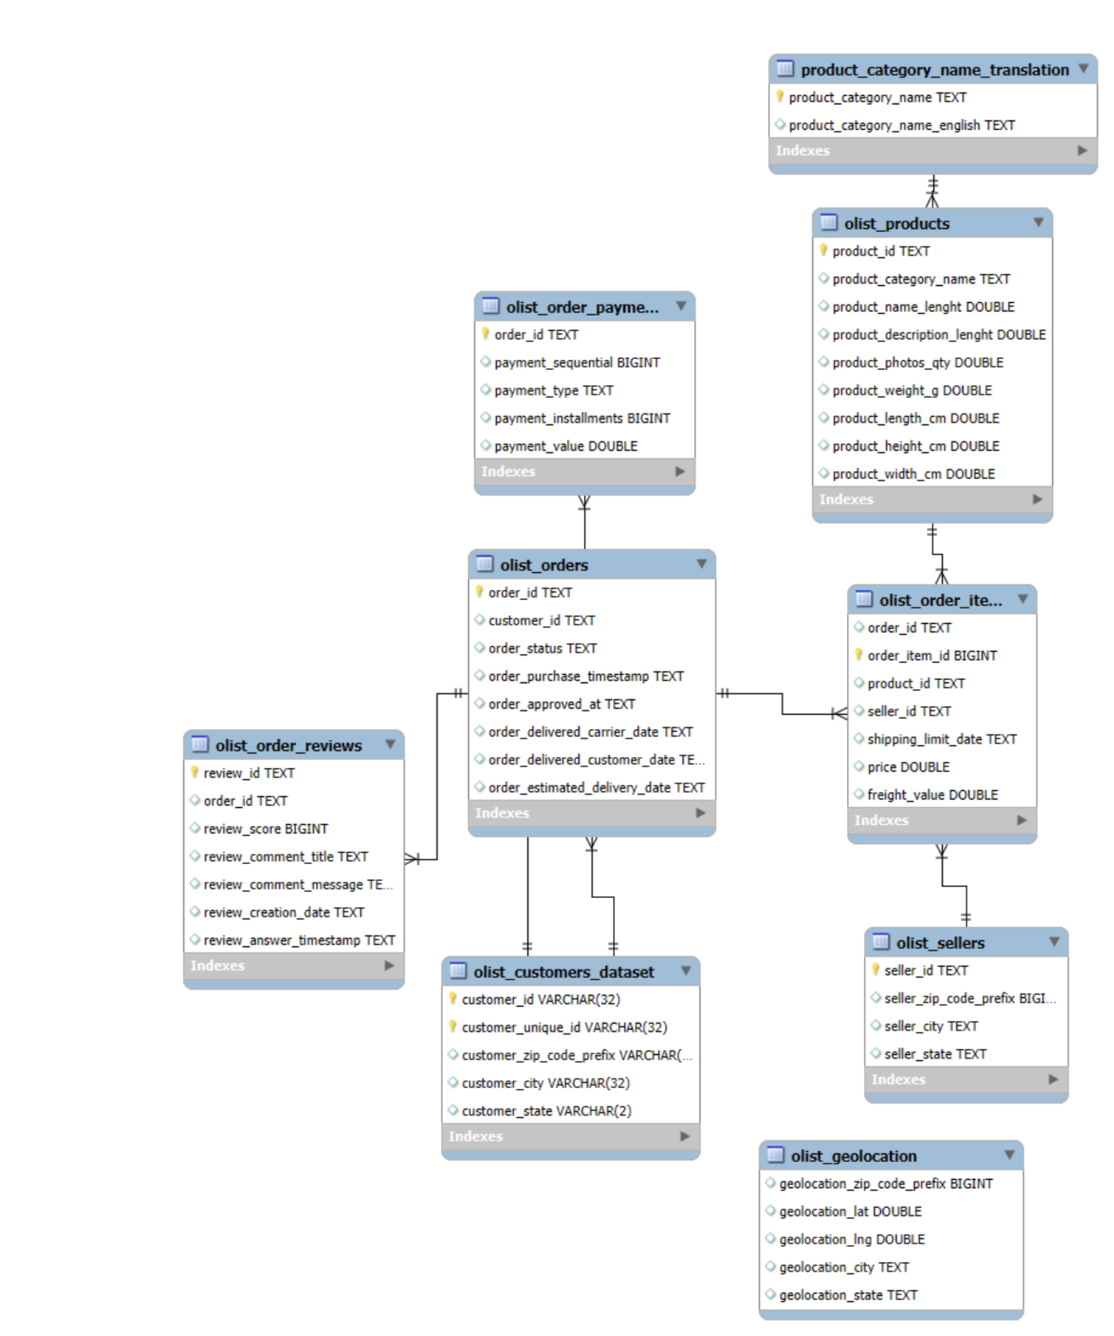

Data Architecture

Slide 8
03
Sales Performance Analysis

Slide 9
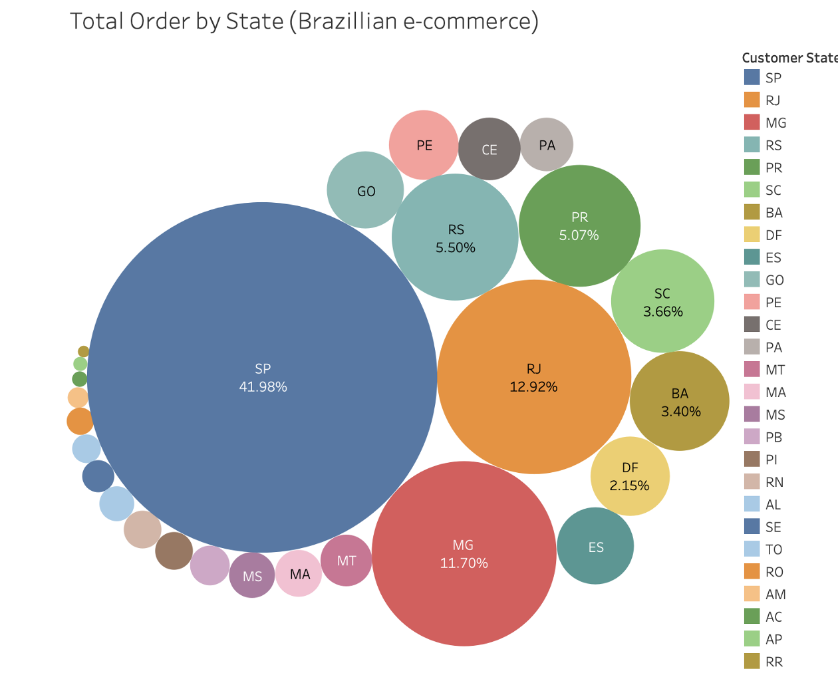
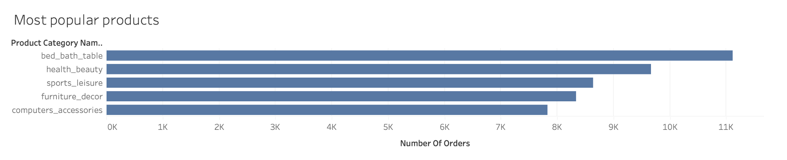
High-Demand Regions and Leading Product Categories
The highest revenue-generating states: São Paulo, Minas Gerais, Rio de Janeiro, and Rio Grande do Sul.
These regions align with Brazil's most economically active areas, making them ideal for companies looking to scale quickly with reduced entry risk.
The top-performing categories are Bed, Bath & Table, Health & Beauty, Sports & Leisure, Furniture & Decor, and Computers & Accessories.
These offer a reliable starting point for product prioritization.

Slide 10
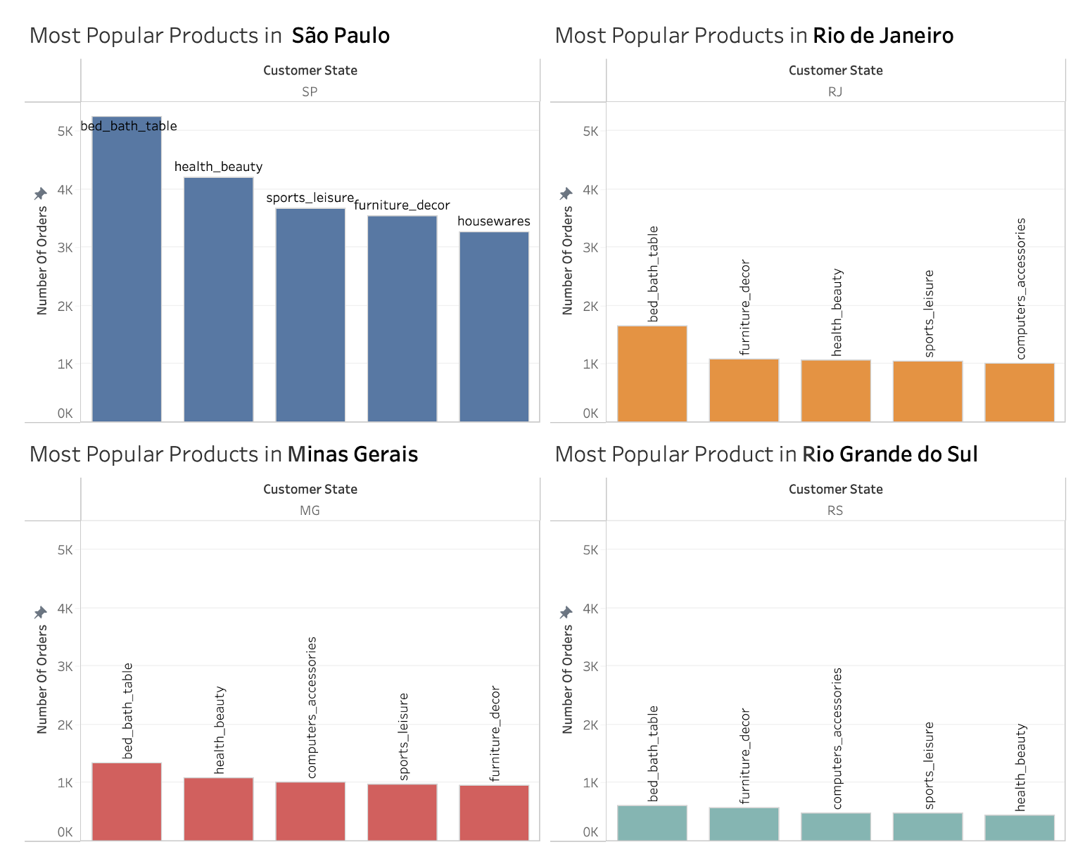
Popular Products consistently appear across high-revenue states
Popular products consistently appear across high-revenue states, though their demand intensity varies by region.
São Paulo stands out for its broad category success, making it an ideal testing ground for launching new products.
Categories like Bed, Bath & Table and Health & Beauty are strong candidates to prioritize, given their repeated success across top markets.
Other high-performing states show more concentrated demand, suggesting that a focused, category-specific strategy may be more effective there.

Slide 11
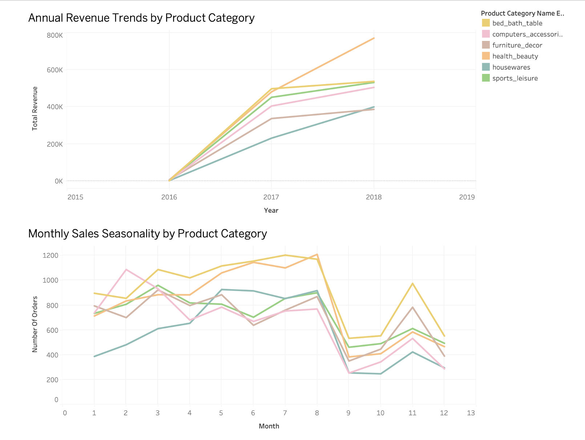
Sales Trends are Increasing Over Time
From 2016 to 2018, sales showed steady growth — particularly in the Health & Beauty category.
Health & Beauty has proven to be a consistently strong performer, both in popularity and year-round stability.
August and November saw clear seasonal spikes across top product categories, offering strategic timing for promotions and inventory planning.

Slide 12
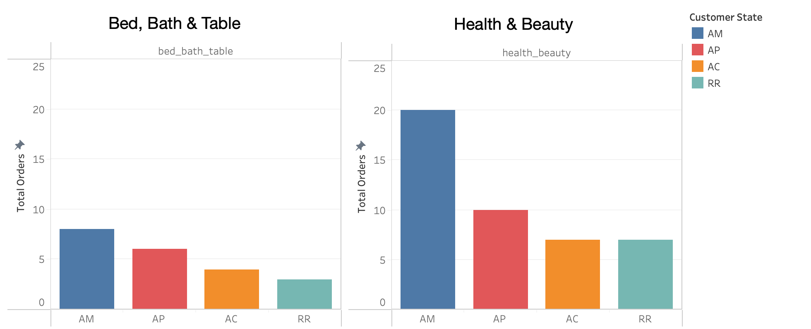
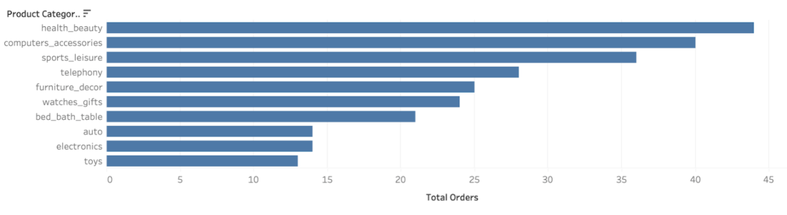
Low Revenue States and Product Performance
Shifting to lower-performing states like AM, AP, AC, and RR, we found very low product penetration.
Even top categories underperformed, though Health & Beauty, Computers & Accessories, and Sports & Leisure showed relatively stronger traction.
Notes:
Now we’re pivoting to examine where the most popular products underperform. These include the states of Amazonas, Amapá, Acre, and Roraima — all of which consistently show the lowest sales for top categories.
However, the chart below highlights product categories that perform relatively better in these low-revenue states. Notably, Health & Beauty, Computer Accessories, and Sports & Leisure show stronger traction. This reinforces the idea that, with the right strategy, these regions may still offer profitable opportunities for targeted growth.

Slide 13
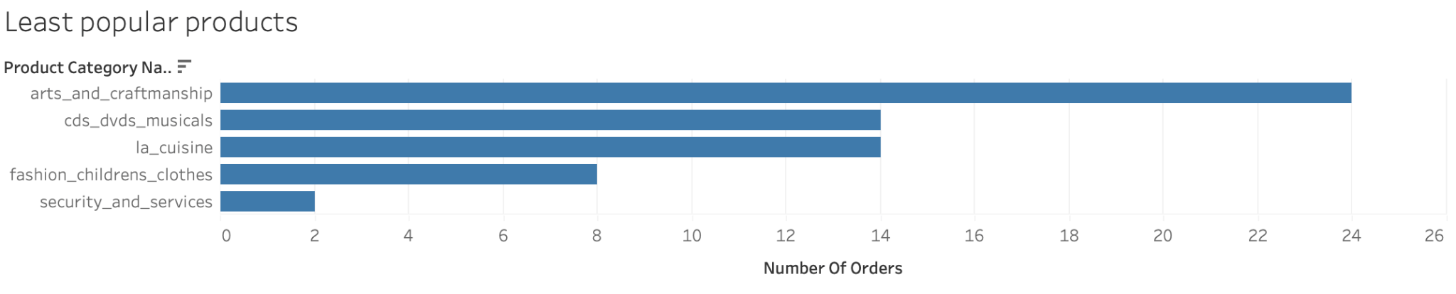
Low Revenue Generating Products
These products emerged as low-performing overall across the dataset.
For companies seeking quick and low-risk market entry, it's wise to be cautious when considering these categories.
However, they may also represent untapped market potential — with the right positioning or product differentiation, these items could unlock niche opportunities and longer-term growth.

Slide 14
04
Customer Segmentation & Targeting

Slide 15
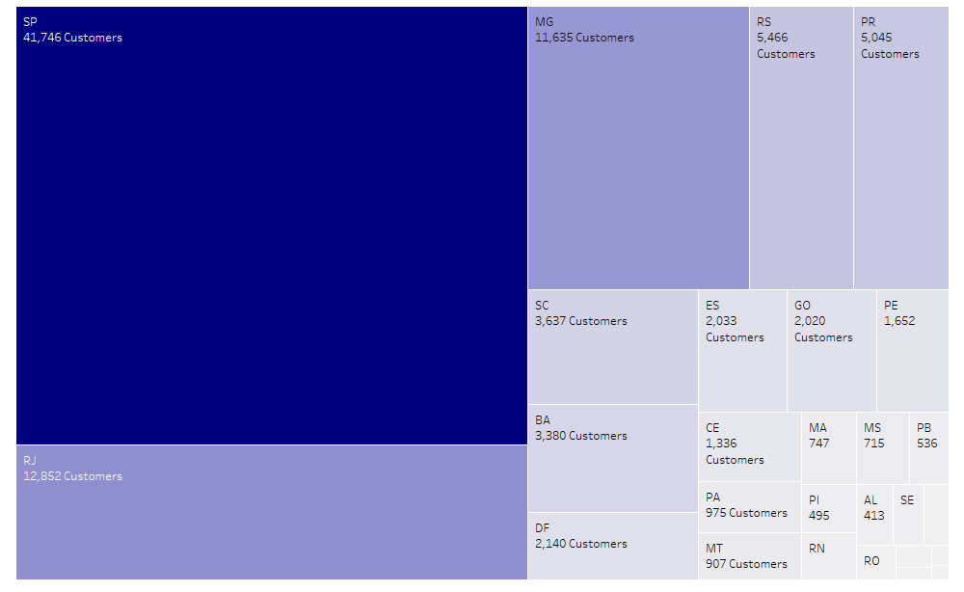
Where Are Brazilian E-Customers?
Notes:
First we observe where are Brazilian E-Customers
As Hemen previously mentioned, and as you can see here, a significant amount of Brazilian e-customers reside in São Paulo, with Rio de Janeiro, Minas Gerais, Rio Grande do Sul and Paraná following after.

Slide 16
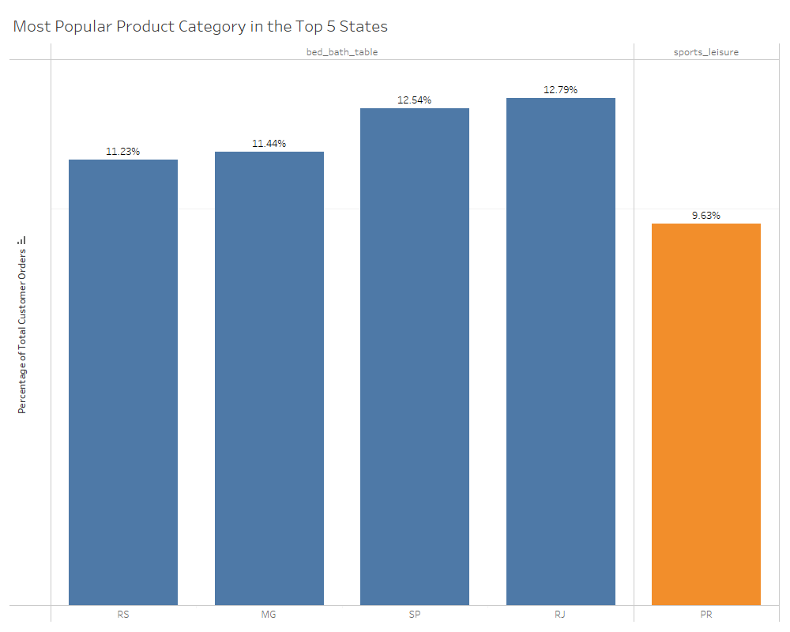
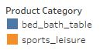
What Product Categories Are The Most Popular Amongst Customers in The Top 5 Populated States?
Notes:
Based on the top 5 States with the highest number of e-customers, we looked at what product category was the most popular amongst customers residing in those states
The percentage above each bar represents the percentage of total distinct customers in each state that ordered products within the state’s most popular product category
We see here that products in the Bed/Bath/Table Category are the most popular amongst customers in São Paulo, Rio de Janeiro, Minas Gerais, and Rio Grande do Sul, and products in the Sports Leisure category are the most popular category for customers in Paraná

Slide 17
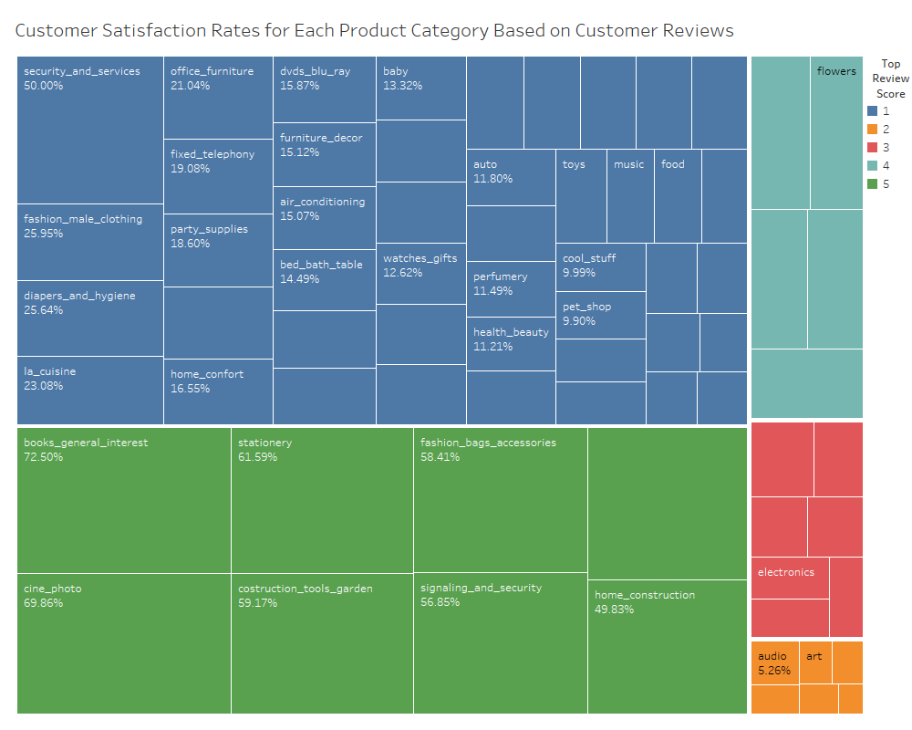
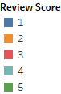
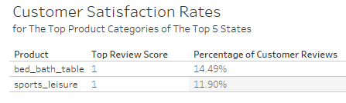
How Satisfied Are Brazilian Customers With Their Orders in These Top Categories?
Notes:
Now we move on to looking at how satisfied Brazilian customers are with the orders they placed
On the right you’ll see that each product category is grouped based on its top review score (1 = very dissatisfied 5 = very satisfied) and labeled with the percentage of total customer reviews that relate to that score.
Looking at the table on the left, you’ll see that the top review score for both of our top product categories is a 1, with 14.49% of reviewing customers highly dissatisfied with their product orders in the bed/bath/table category and 11.90% of reviewing customers highly dissatisfied with their product orders in the sports leisure category.
These values aren’t too concerning, seeing as product categories that also have a top review score of 1, like security and services, have a dissatisfaction rate of 50% amongst order reviewing customers.

Slide 18
05
Pricing Strategy & Optimization

Slide 19
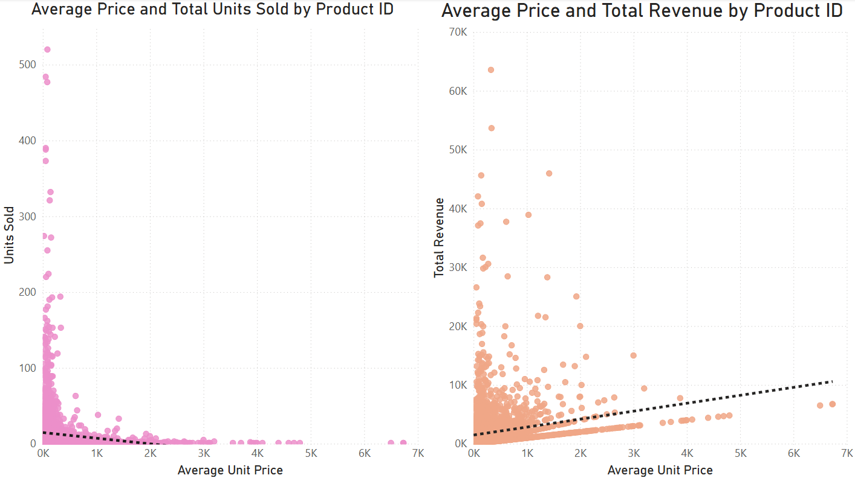
Volume and revenue have an opposite correlation to average price given the product
01
02
Negative correlation for Volume vs Price
People buy less when price high
Positive correlation for Revenue vs Price
More money when price high
Price drives revenue more than volume

Slide 20
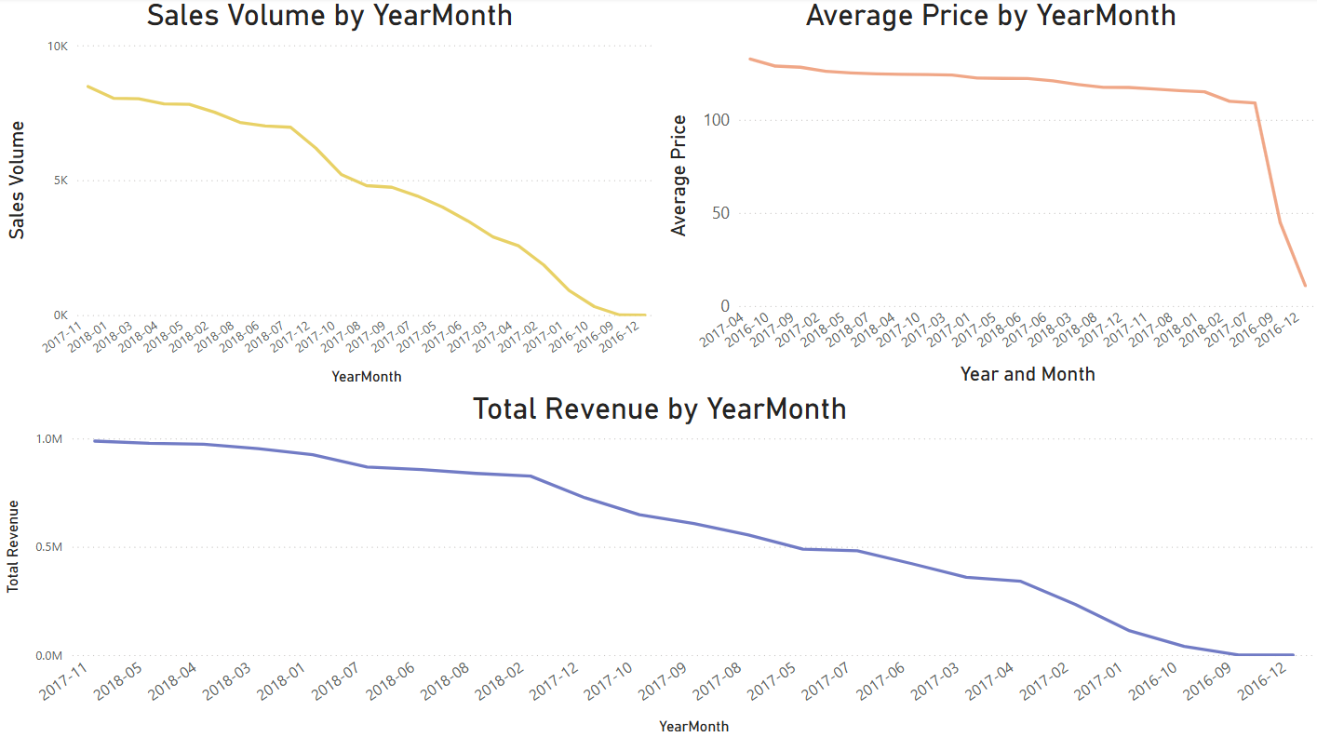
19
High monthly average product price causes low monthly volume and revenue and vice versa.
2017-11 - high volume (8,500) and high revenue (988k)
2017-11 also low unit price (116.5)
2017-04 - low volume (2570) / low revenue (341k)
2017-04 also high unit price (132.6)

Slide 21
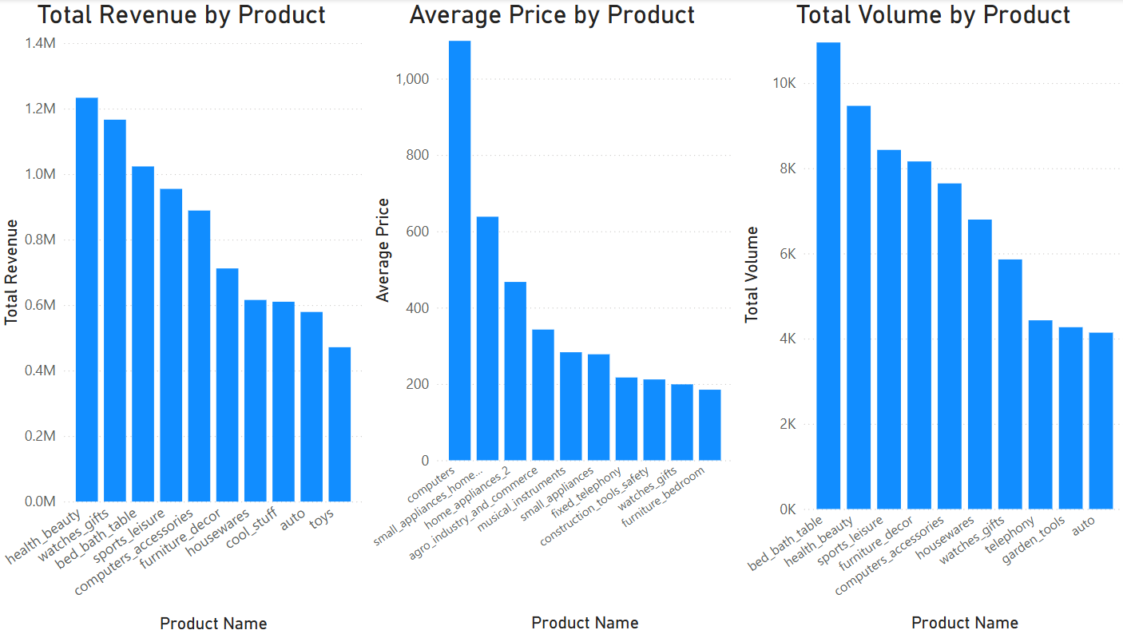
Products with high revenue and high sales tend to not have high average unit price
High volume products have high revenue
High volume products tend toward lower price
Higher priced items one-time purchases
Focus on repeat purchasable products

Slide 22
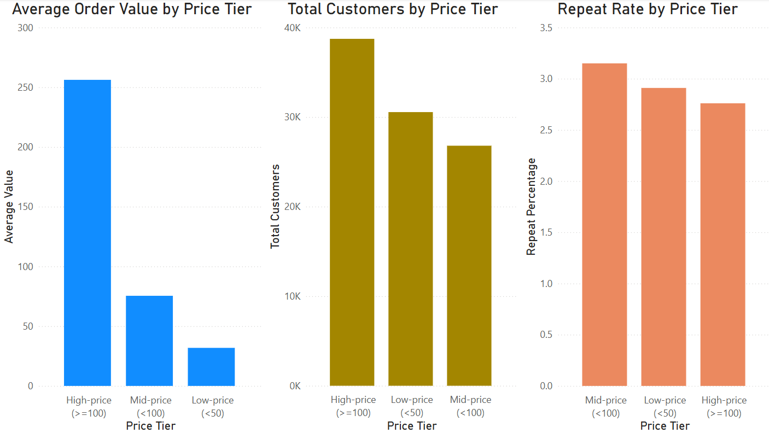
21
Mid price tier customers tend to repeat purchases more often than low or high tier customers
Mid-price = lowest customer count, highest repeat rate
High-price = highest customer count, lowest repeat rate
Focus on revenue or customer retention

Slide 23
06
Supply Chain Logistics

Slide 24
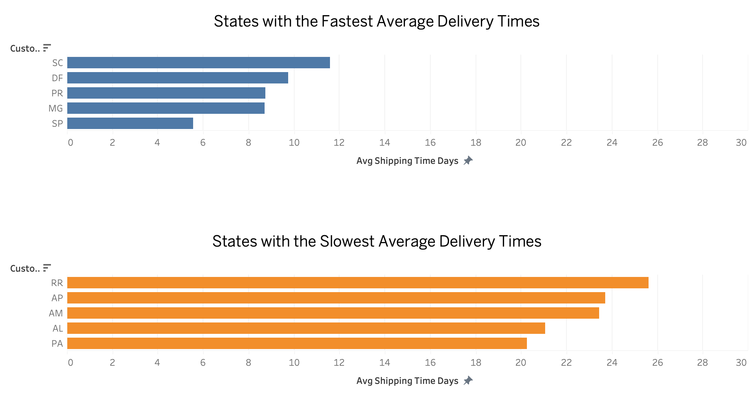
Delivery Times
Notes:
This visualization compares the average shipping times across Brazilian states, highlighting both the fastest and slowest performers. Among the fastest states are Santa Catarina (SC), Distrito Federal (DF), Paraná (PR), Minas Gerais (MG), and São Paulo (SP). Notably, SP and MG are two of the top revenue-generating states, showing not only strong sales but also efficient logistics. This suggests a mature and well-optimized supply chain in these regions, making them strongholds for further investment and scaling.
On the other hand, the states with the slowest delivery times are Roraima (RR), Amapá (AP), Amazonas (AM), Alagoas (AL), and Pará (PA). Of these, RR, AP, and AM are also among the lowest revenue-generating states. The overlap of low demand and logistical inefficiencies could indicate underdeveloped infrastructure, geographic challenges, or distribution network limitations. While these regions may present long-term growth opportunities, they currently pose risks in terms of fulfillment performance, which is important for customer satisfaction and cost control.

Slide 25
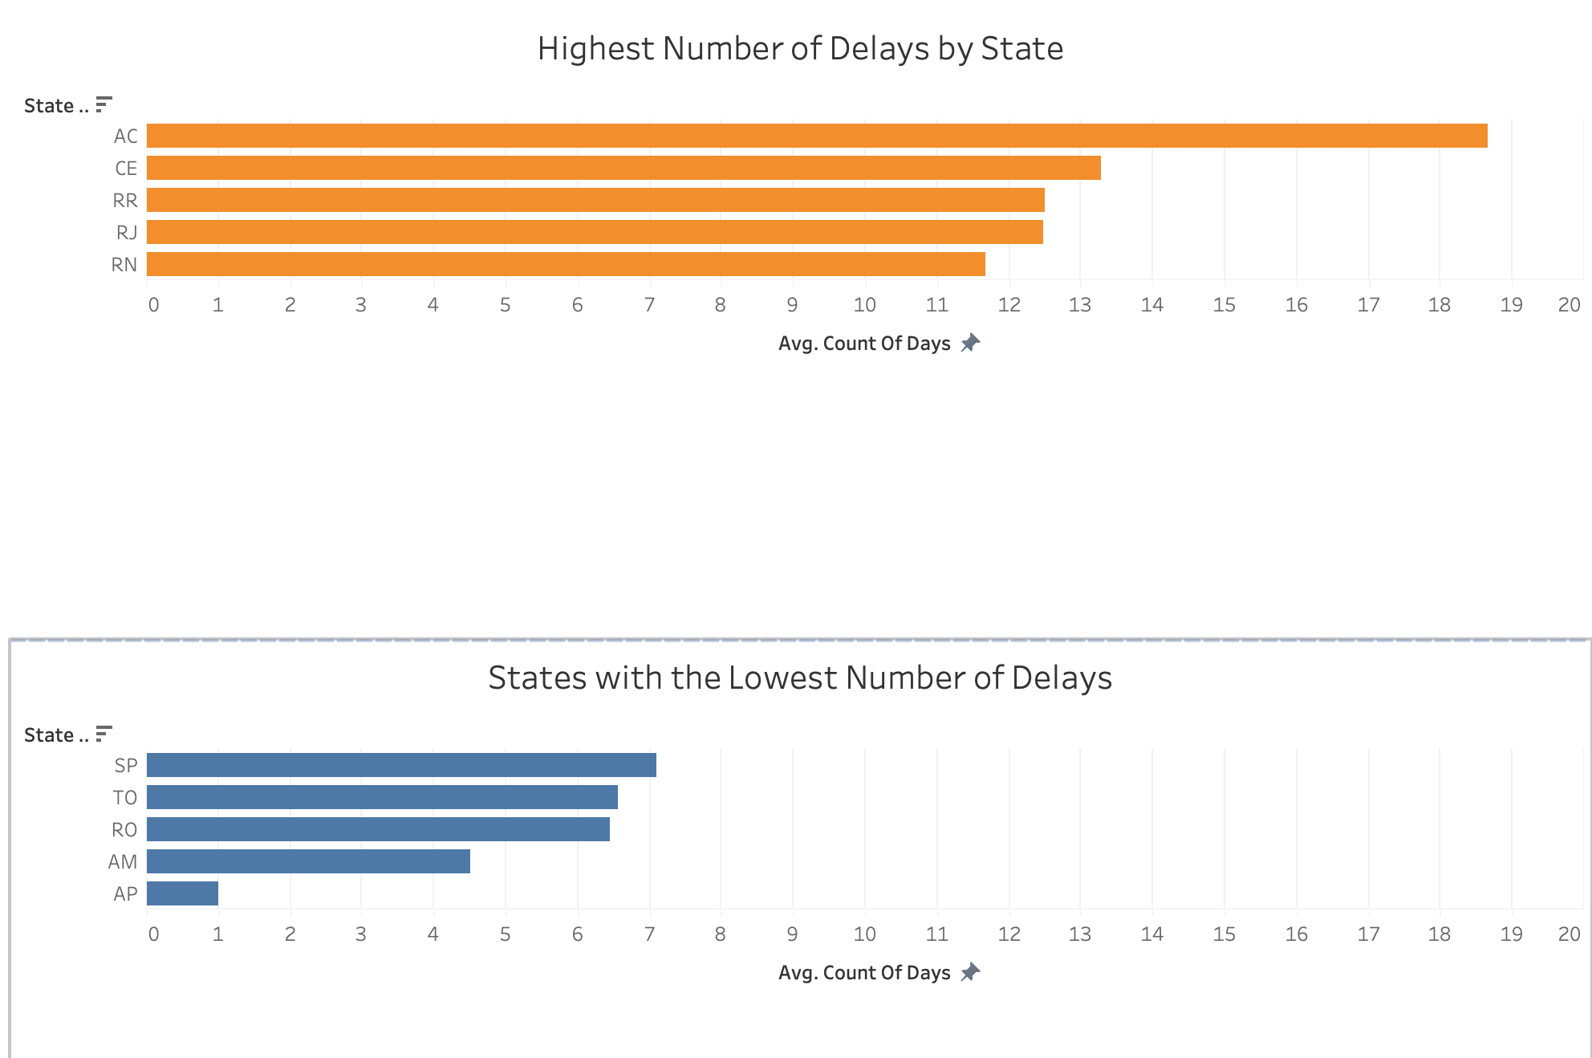
Delays
Notes:
This visualization highlights the states with the highest and lowest average delivery delays — specifically where orders arrived later than estimated.
The top 5 states with the longest delivery delays are Acre (AC), Ceará (CE), Roraima (RR), Rio de Janeiro (RJ), and Rio Grande do Norte (RN). Notably, AC and RR are among the lowest revenue-generating regions, which may reflect limited infrastructure, geographic remoteness, or supply chain inefficiencies. On the other hand, RJ is a top revenue-generating state, making its presence here a red flag — persistent delays in such a major market could undermine customer satisfaction and loyalty.
In contrast, states like São Paulo (SP) and Amazonas (AM) show the shortest average delays. SP’s strong logistics likely support its high order volume, while AM’s performance is promising considering it is a low-revenue state — indicating possible hidden logistical strengths or efficient last-mile delivery in certain pockets.
This section provides an initial overview of Brazil’s e-commerce logistics landscape, highlighting patterns in delivery times, delays, and processing efficiency across regions and product categories. While the logistics setup of a new company may differ, these historical insights offer a practical foundation for understanding infrastructural realities and potential challenges.
We observe that some low-revenue states such as Acre (AC) and Roraima (RR) consistently face longer delivery delays, suggesting logistical bottlenecks, geographic inaccessibility, or limited last-mile delivery infrastructure. In contrast, high-performing regions like São Paulo (SP) demonstrate strong logistical performance, with faster delivery times and fewer delays—likely due to established infrastructure and urban density.
Interestingly, Rio de Janeiro (RJ), despite being a top revenue-generating state, appears frequently among the slowest or most delayed regions, indicating that even well-established markets may benefit from targeted logistical improvements.

Slide 26
Takeaways
Tailored logistics planning is critical: Some regions may require additional investment or third-party partnerships to ensure timely delivery and reduce customer churn.
High-volume states like RJ deserve deeper analysis to identify why delays persist and how infrastructure or fulfillment practices might be improved.
Seemingly low-potential regions like AM may offer unexpected logistical advantages, suggesting they shouldn’t be overlooked in expansion strategies.

Slide 27
07
Recommendations

Slide 28
Focus initial market entry on top-performing states:
São Paulo (SP), Minas Gerais (MG), Rio de Janeiro (RJ), and Rio Grande do Sul (RS) show strong sales, logistics, and customer density
Use São Paulo as a launchpad for testing broad product mixes
Prioritize high-performing product categories:
Lead with Bed, Bath & Table, Health & Beauty, and Computers & Accessories
Health & Beauty offers stable year-round performance—even in low-revenue states

Slide 29
Tailor product marketing by region:
SP, RJ, MG, RS: Emphasize Bed/Bath/Table and Health & Beauty
Paraná: Focus on Sports & Leisure
Highlight product quality to reduce dissatisfaction in top categories
Align pricing with customer behavior:
Stock affordable, repeat-purchase products for long-term loyalty
Use strategic pricing for one-time, high-ticket items (e.g., Computers)
Target mid-tier spenders—they have the highest repeat purchase rate

Slide 30
Capitalize on seasonal shopping spikes:
Boost marketing promotions and inventory ahead of August and November
Address dips in September and December with retention campaigns
Invest in region-specific logistics improvements:
Address persistent delays in RJ to protect customer satisfaction
Explore expansion in AM due to promising delivery efficiency
Be cautious in AC, AP, and RR due to poor logistics and low demand

Slide 31
THANK YOU!
ANY QUESTIONS?

